Slide 1
PRESENTED BY DIVYANSH JAIN
JULY, 2024
Amazon Sales Analysis

Slide 2

Introduction
Agenda
Business Problem Statement
Data Source
Project Statement
Tools Used
Data Cleaning
Sales Overview
Product Analysis
Fulfilment Analysis
Customer Segmentation
2

Slide 3

Introduction
Orders
Sales
This report presents an overview of the interactive dashboard developed to analyse and visualize Amazon sales data. Leveraging the capabilities of Python and Power BI, this dashboard aims to provide an intuitive and dynamic interface for exploring key metrics and trends in the dataset.
The primary objective of this dashboard is to enhance the accessibility and interpretability of complex sales data for a broad audience, including business analysts, marketing professionals, and decision-makers. By transforming raw data into visually compelling and interactive elements, users can gain actionable insights with ease.

Slide 4

Business Problem Statement
The provided dataset contains information about sales transactions on Amazon, including details such as order ID, date, status, fulfilment method, sales channel, product category, size, quantity, amount, shipping details, and more. The objective is to conduct a comprehensive analysis of the data and extract actionable insights to support business decision-making

Slide 5

Data Source
The dataset used for this analysis comprises information from Innobyte Company. It includes a total of 16355 records with 16 attributes.
Key features such as index, Order ID, Date, Status, Fulfilment, ship-service-level, Category are included, providing a comprehensive view of the workforce dynamics.
The dataset has been preprocessed to handle missing values and encoded for analysis, aiming to identify significant predictors of attrition and propose data-driven strategies to mitigate it.

Slide 6

Project Statement
1. Sales Overview: Understand the overall sales performance, trends, and patterns over time.
2. Product Analysis: Analyze the distribution of product categories, sizes, and quantities sold to identify popular products.
3. Fulfillment Analysis: Investigate the fulfillment methods used and their effectiveness in delivering orders.
4. Customer Segmentation: Segment customers based on their buying behavior, location, and other relevant factors.
5. Geographical Analysis: Explore the geographical distribution of sales, focusing on states and cities.
6. Business Insights: Provide actionable insights and recommendations based on the analysis to optimize sales
strategies, improve customer satisfaction, and enhance overall business performance.

Slide 7

Tools Used
Python
Pandas
Matplotlib & Seaborn Scikit-Learn
Power BI
GitHub
For Data cleaning & Exploratory Data Analysis (EDA)
For Data manipulation and analysis
For Data Visualization
For Feature Analysis and Predictive Analysis
For Data Visualization Using Dashboards
For Documentation
7

Slide 8

Data Cleaning
Data Cleaning process involves fixing or removing incorrect, corrupted, incorrectly formatted, duplicate, or incomplete data within a dataset, to prepare data for analysis.
Dropping Unnecessary Columns: We have identified 2 columns with constant values across all entries, making them irrelevant for analysis. These columns will be dropped.
Handling Missing Values: Four columns contain missing entries. We will use mean imputation, which replaces missing values with the average of the existing values in those columns.
Handling Duplicated Entries: No duplicated entries were found in the data.
8

Slide 9
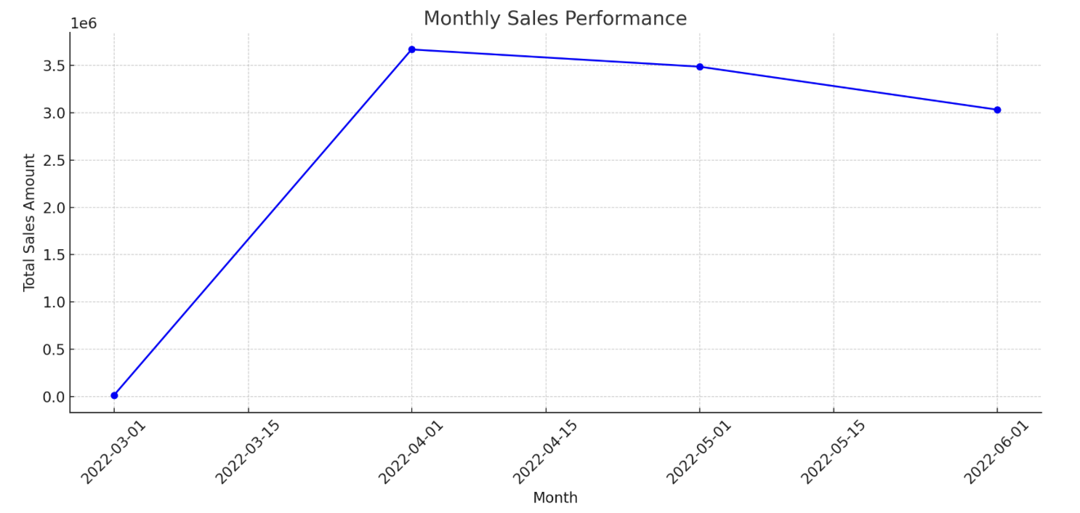
Sales Overview
Mar.–Apr. 2022
There was a significant increase in sales from March to April 2022.
Apr. 2022 and May 2022
The sales remained relatively high in April and May 2022.
Apr. 2022
There is a slight decline in June 2022 compared to the peak in April 2022.
9

Slide 10
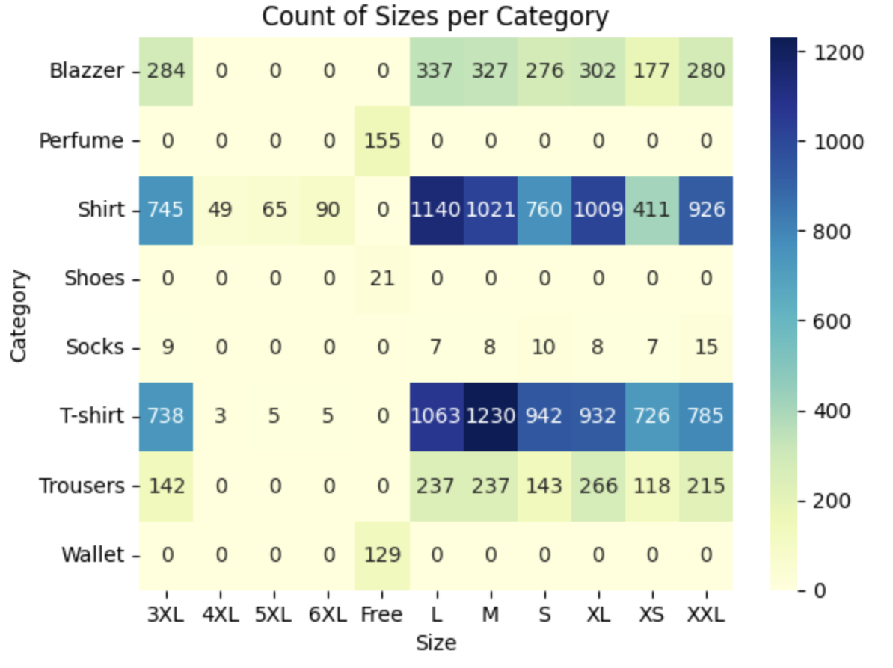
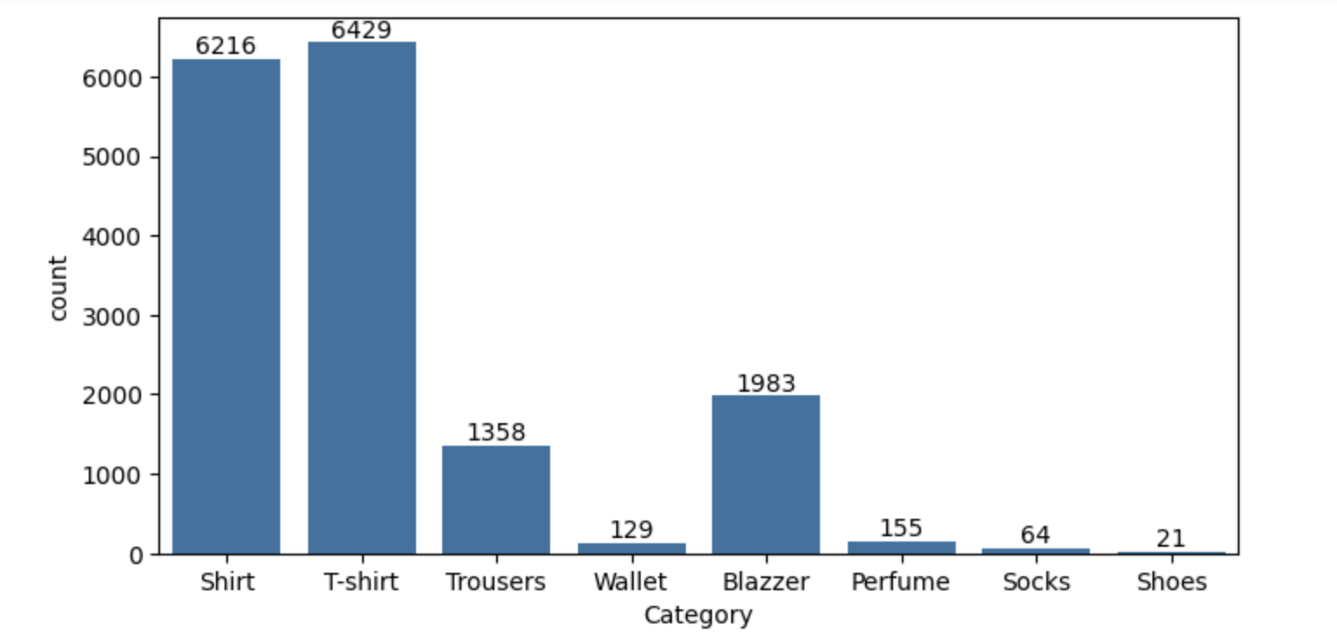
Product Analysis
Highest sold product is T-shirt
Medium size has the highest bar in the size distribution plot. It indicates that Medium-Sized clothing items are particularly popular.
9

Slide 11
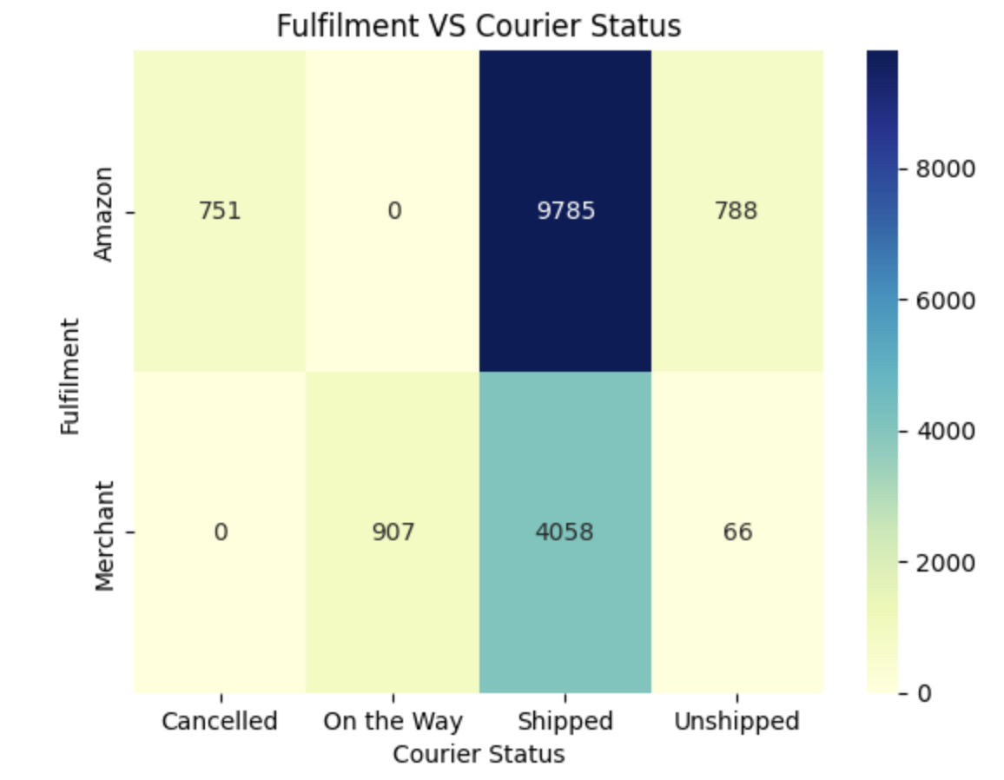
Fulfillment Analysis
Amazon has a total Fulfilment of 11324 orders.
Merchant has a total Fulfilment of 5031 orders.
Amazon has the highest number of shipped, cancelled and unshipped courier status orders.
Merchant has highest number of on the way courier status orders.
9

Slide 12
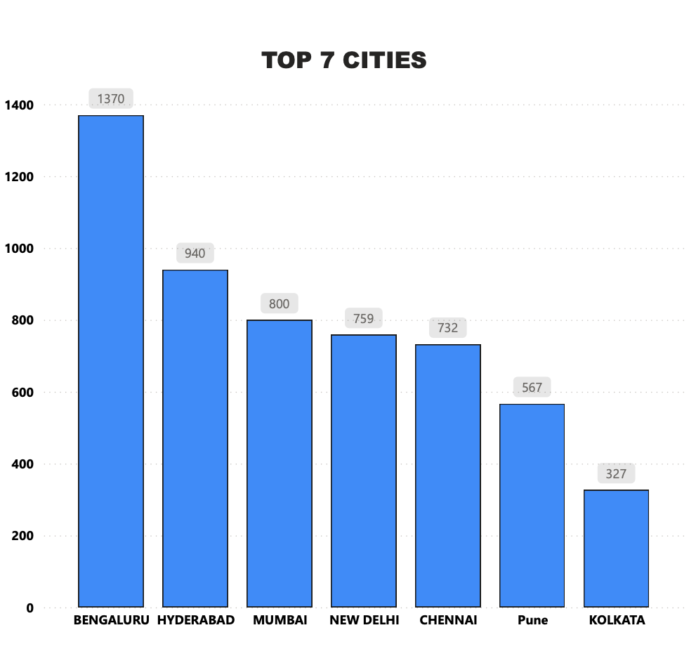
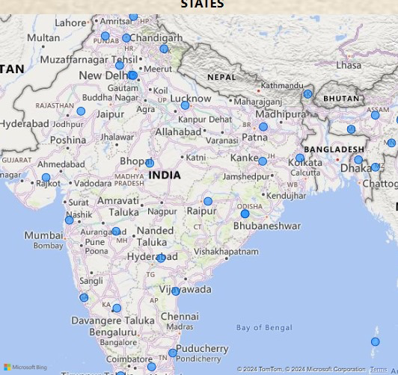
Customer Segmentation
9

Slide 13

Thank You ! For Your Time
Presented By
Divyansh Jain

